Slide 1
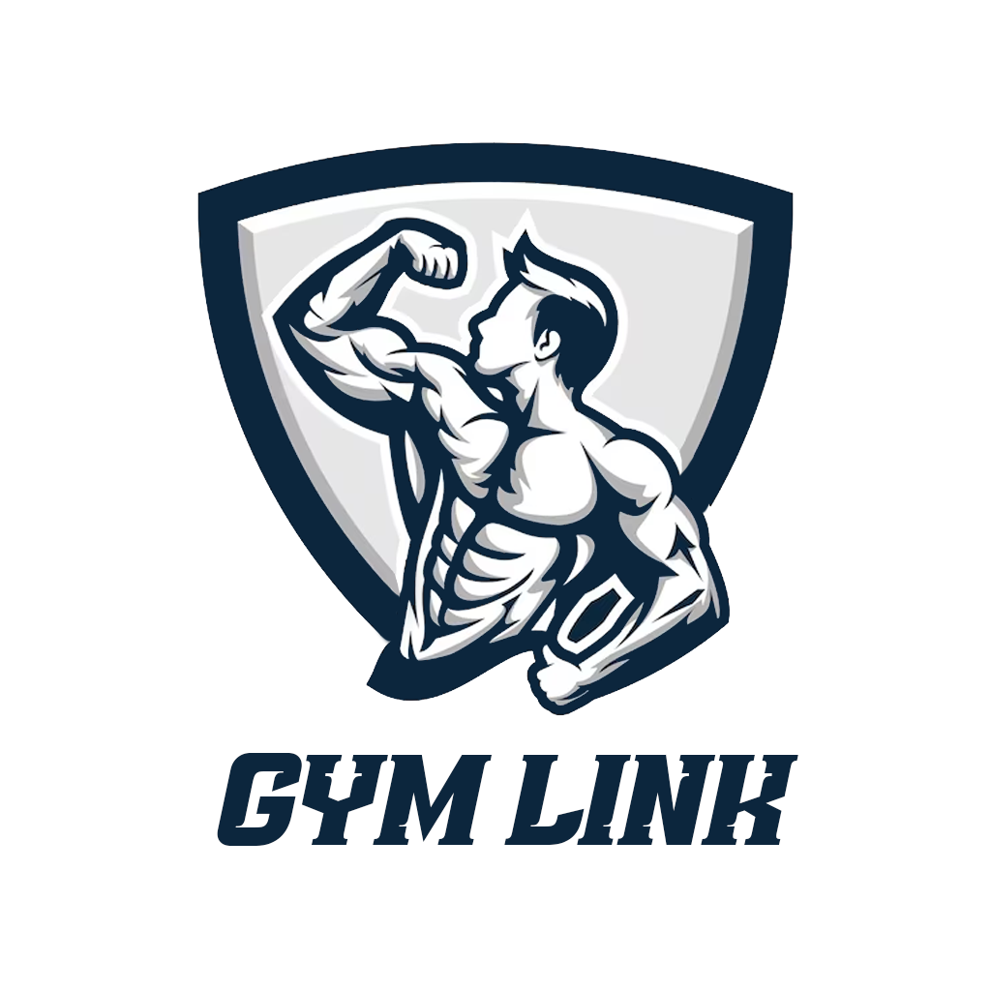
Building Stronger Connections
Enhancing Gym Experiences with GYM LINK

Slide 2


OFPPT
ISMO - Tetouan
Development of a GYM management application
Achieved by:
Ataa EL Azhari
Supervised by:
MR.Mohamad Lamnaouar

Slide 3

Summary
Introduction
Problem statement
Solution
Main functionalities
Analysis
Use case diagram
Class diagram
Sequence diagrams
Data structure
Used technologies
Final interfaces
Conclusion

Slide 4
Introduction

Slide 5
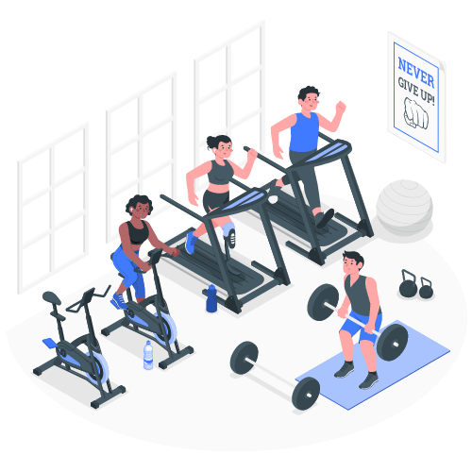
Introduction
The inspiration for creating GYM LINK stemmed from recognizing the challenges and inefficiencies present in the traditional fitness industry. We were driven by a vision to simplify the process of joining gyms, accessing fitness classes, and managing memberships.

Slide 6

Problem statement
Manual Membership Management: Traditional gym operations often involve manual processes for managing memberships.
Tedious Class Scheduling: Gym owners and staff face challenges in scheduling and managing fitness classes, often relying on spreadsheets or manual methods.
Inconvenient Payment Processes: Traditional payment methods for gym memberships involve physical paperwork and in-person payments.
Lack of Member Engagement: Without a digital platform, gyms may struggle to engage with their members effectively.

Slide 7
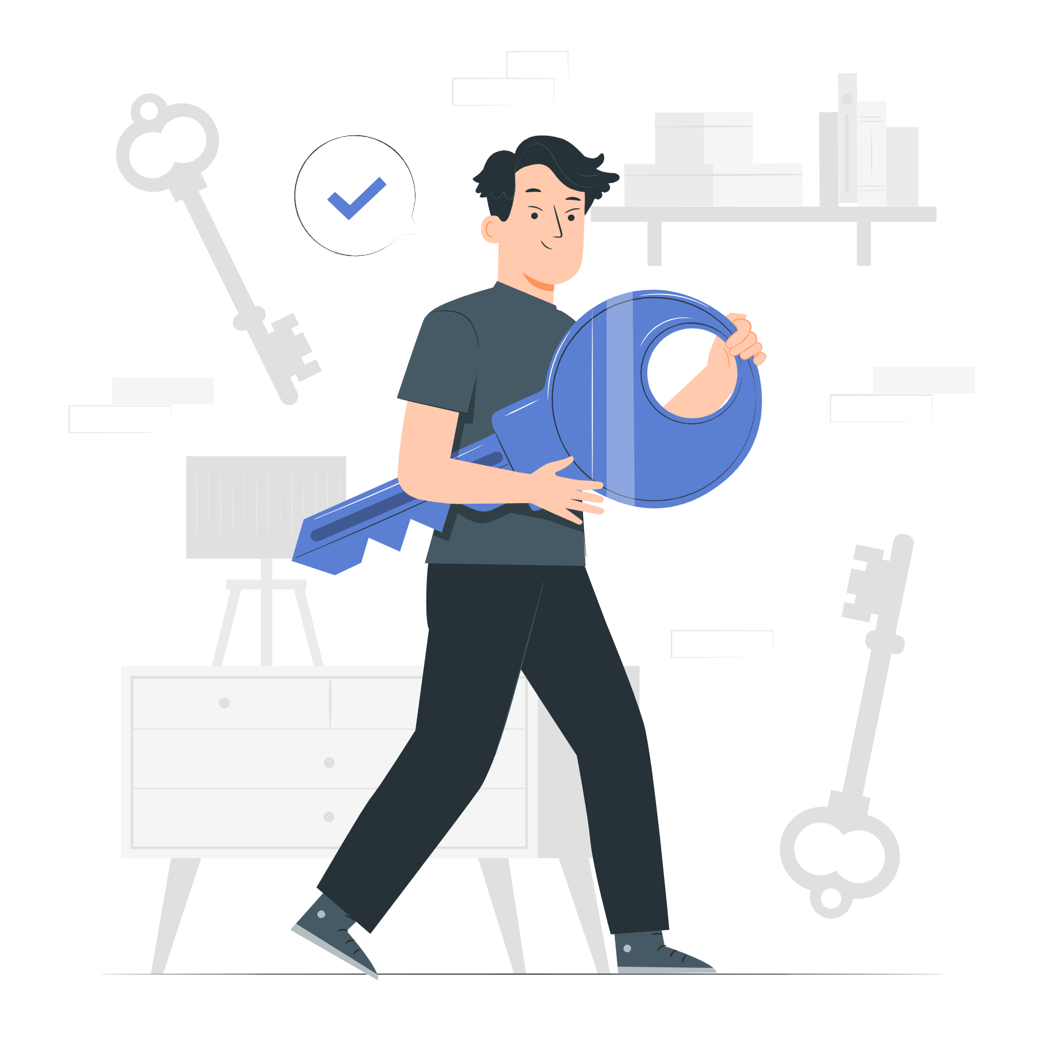
Our solution: GYM LINK
GYM LINK is a comprehensive solution designed to streamline gym operations and enhance the member experience.
GYM LINK offers features such as membership management, class scheduling, online payments, and data analytics.
With GYM LINK, gym owners can automate manual processes and reduce administrative tasks
With GYM LINK, members can enjoy convenient online registration and access to their membership details through a user-friendly interface.

Slide 8
Main Functionalities

Slide 9
Main Functionalities
Our Gym Link app provides comprehensive features that cater to the needs of three key actors: trainees, admins, and coaches.
User Registration: Users can easily create an account by providing their personal information.
Membership Management: Trainees have access to their membership details. On the other hand, the admin has the ability to manage these membership plans.
Class Booking and Scheduling: The app should provide a feature for users to book fitness classes offered by the gyms.

Slide 10
Analysis

Slide 11
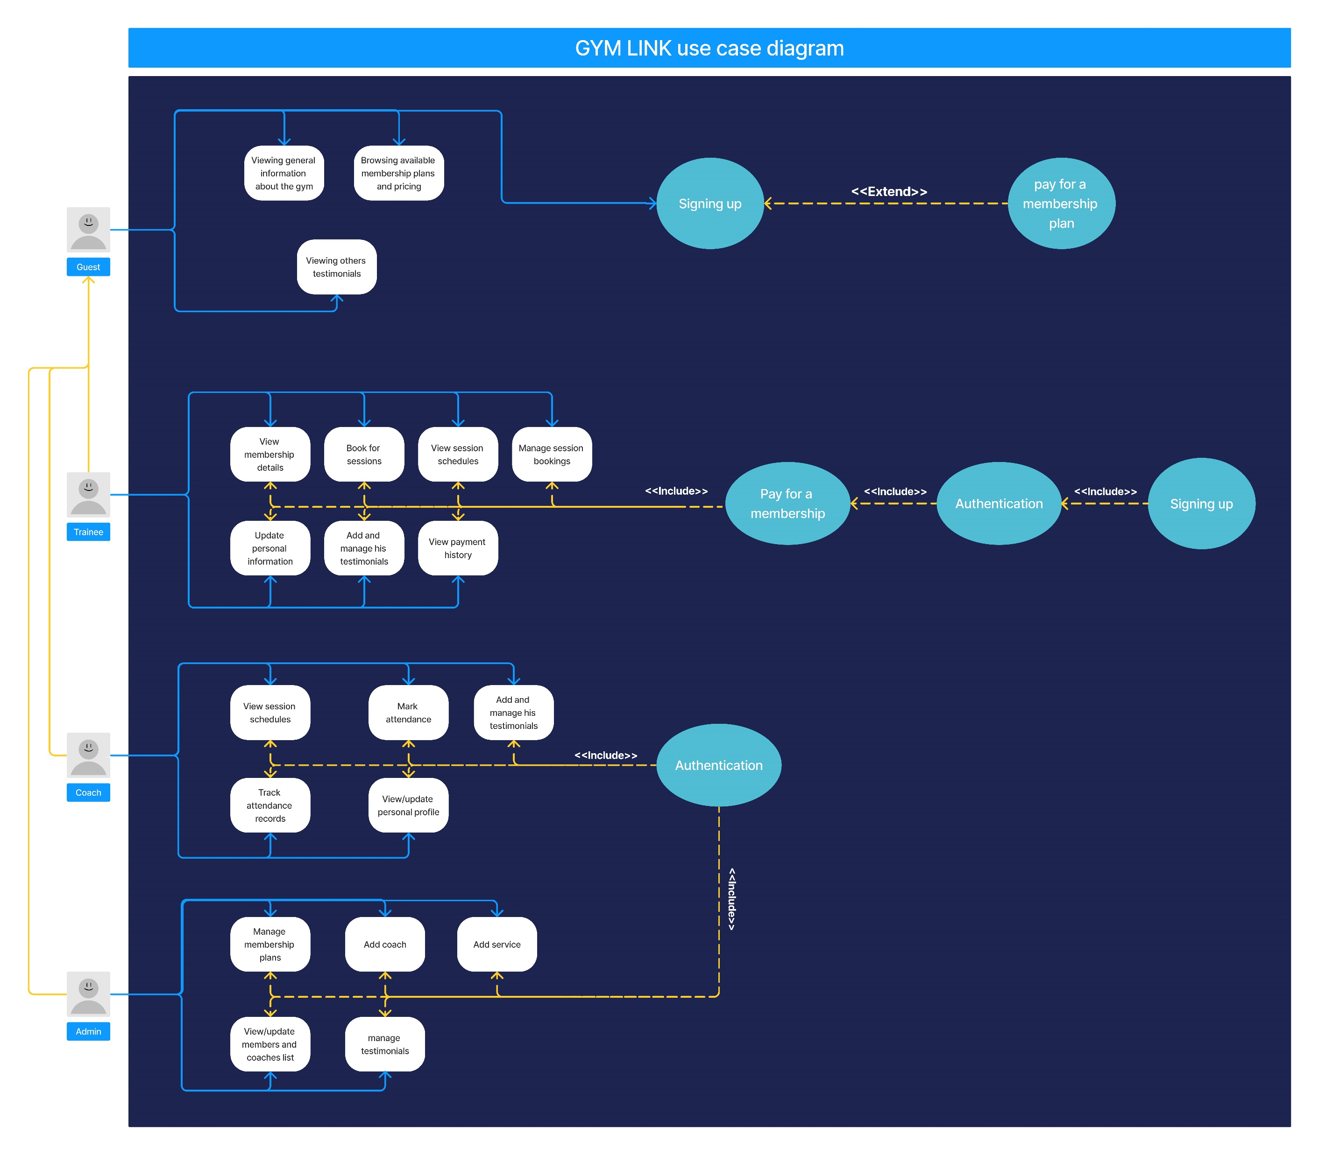
Use case diagram
The use case diagram for Gym Link visually represents the various interactions and functionalities of the app. It showcases how gym owners, coaches, and members interact with the application

Slide 14
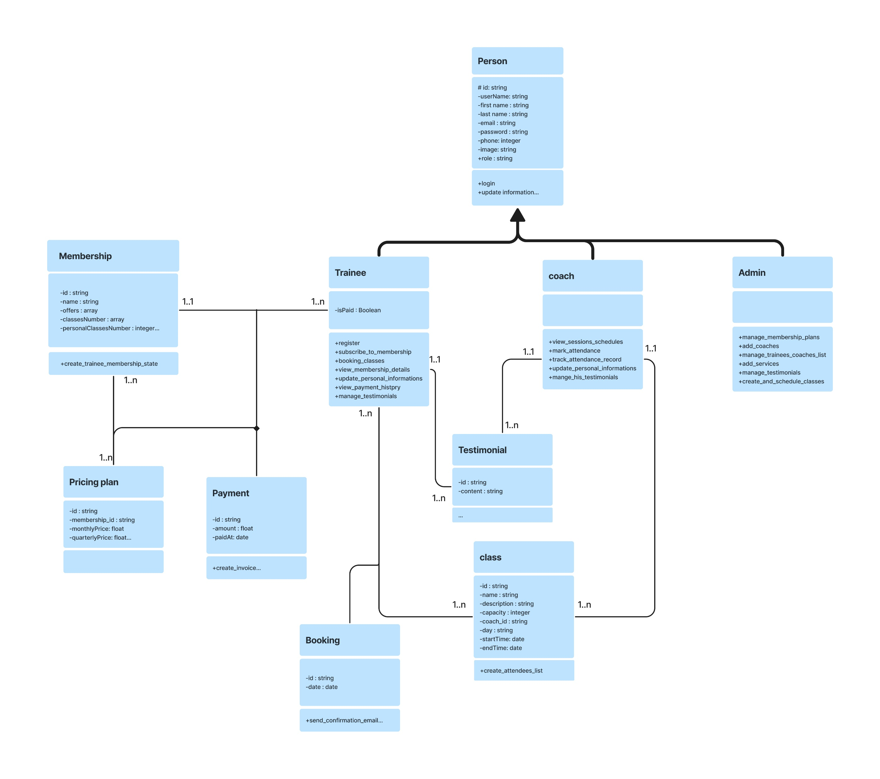
Class diagram
The class diagram for Gym Link illustrates the essential classes and their relationships within the app's architecture.

Slide 15
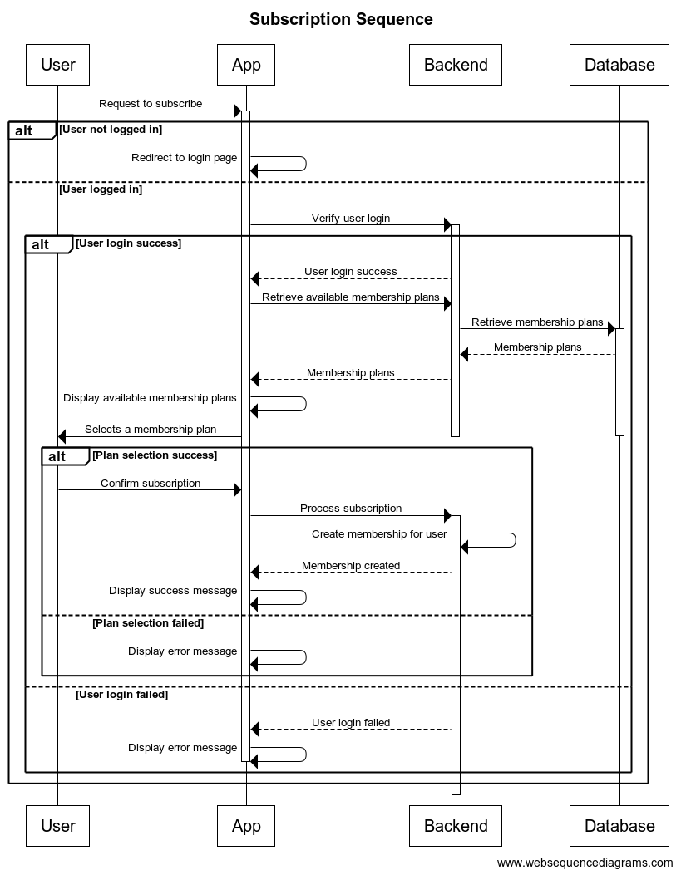
Sequence diagram
The sequence diagram for subscribing in a membership in Gym Link showcases the step-by-step interactions between the user and the application during the subscription process.

Slide 16

The microservices
To build a scalable and flexible application architecture, GYM LINK was developed as a microservice-based application.
User management service: The User Management Service handles user-related functionalities such as user registration, authentication, and profile management.
Membership management service and payment: The Membership Management Service is responsible for managing gym memberships and payment within the Gym Link application.
Classes scheduling service: The Classes Scheduling Service focuses on managing fitness classes offered by gyms within the Gym Link application.
Notification service:The Notification Service plays a vital role in keeping users informed and engaged. It handles the delivery of notifications to users regarding various events and updates within the Gym Link application.

Slide 17
Data Structure
The Gym Link application utilizes MongoDB as its database management system. The database consists of several collections that store different types of data related to the application's functionality.
Users collection
This collection stores information about registered users of the application. Each document represents an individual user.
Membership_plans Collection
The Memberships collection stores data related to available membership plans. Each document represents a membership
Membership_pricing collection
The Pricing collection stores pricing information for the gym memberships.
Payments collection
The Payments collection stores information about the payments made by trainees for their gym memberships.
Classes collection
This collection stores information about the fitness classes offered by the gym.
Booking collection
This collection keeps track of trainees' bookings for fitness classes.

Slide 18
Used Technologies

Slide 19





Used Technologies
In developing our Gym Link app, we carefully selected and utilized specific technologies to ensure an efficient and robust solution.
we employed the MERN (MongoDB, Express.js, React.js, Node.js) stack, which comprises a powerful set of technologies known for their efficiency and scalability.

Slide 20




React.js:
React.js is a popular frontend JavaScript library known for its component-based architecture and efficient rendering. React.js enables us to build reusable UI components, providing a modular and maintainable codebase. Its virtual DOM and efficient rendering algorithm contribute to improved performance and a smooth user interface.
MongoDB:
As the database component, MongoDB offers a flexible and scalable NoSQL database solution. It excels in handling large amounts of data and provides easy integration with Node.js
Express.js:
Express.js is a minimalistic and highly flexible web application framework for Node.js. It provides a robust set of features and middleware, allowing us to build scalable and performant backend APIs. Express.js simplifies routing and request handling.
Node.js:
Node.js serves as the runtime environment for our application's backend. It allows us to run JavaScript on the server-side, facilitating seamless communication between the frontend and backend components.

Slide 21


Used Technologies
To build a scalable and flexible application architecture, GYM LINK was developed as a microservice-based application.
To further enhance the deployment and management of these microservices, Docker and NGINX was utilized.
Docker:
Docker provided a lightweight and portable environment for each microservice, ensuring consistency across different deployment environments.
NGINX:
Nginx was employed as a reverse proxy server to efficiently route incoming requests to the respective microservices, enhancing performance and load balancing.

Slide 22
Final Interfaces

Slide 23
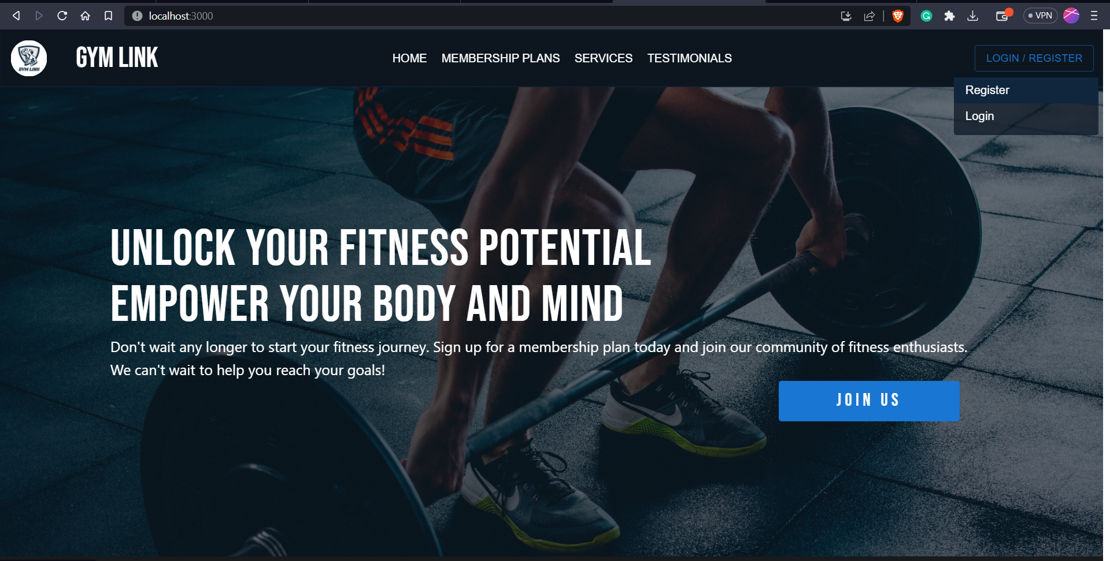

Slide 24
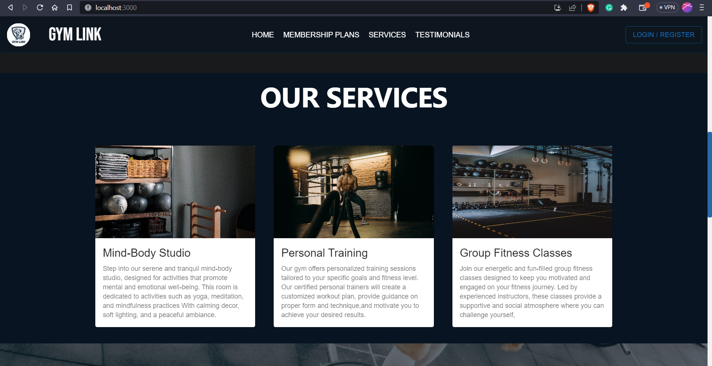

Slide 25
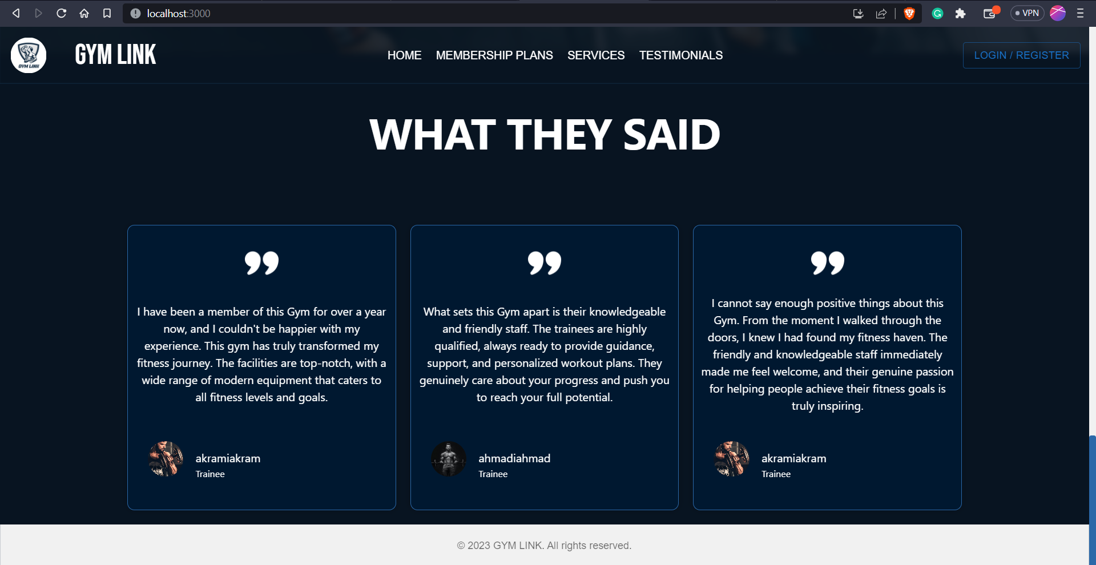

Slide 26
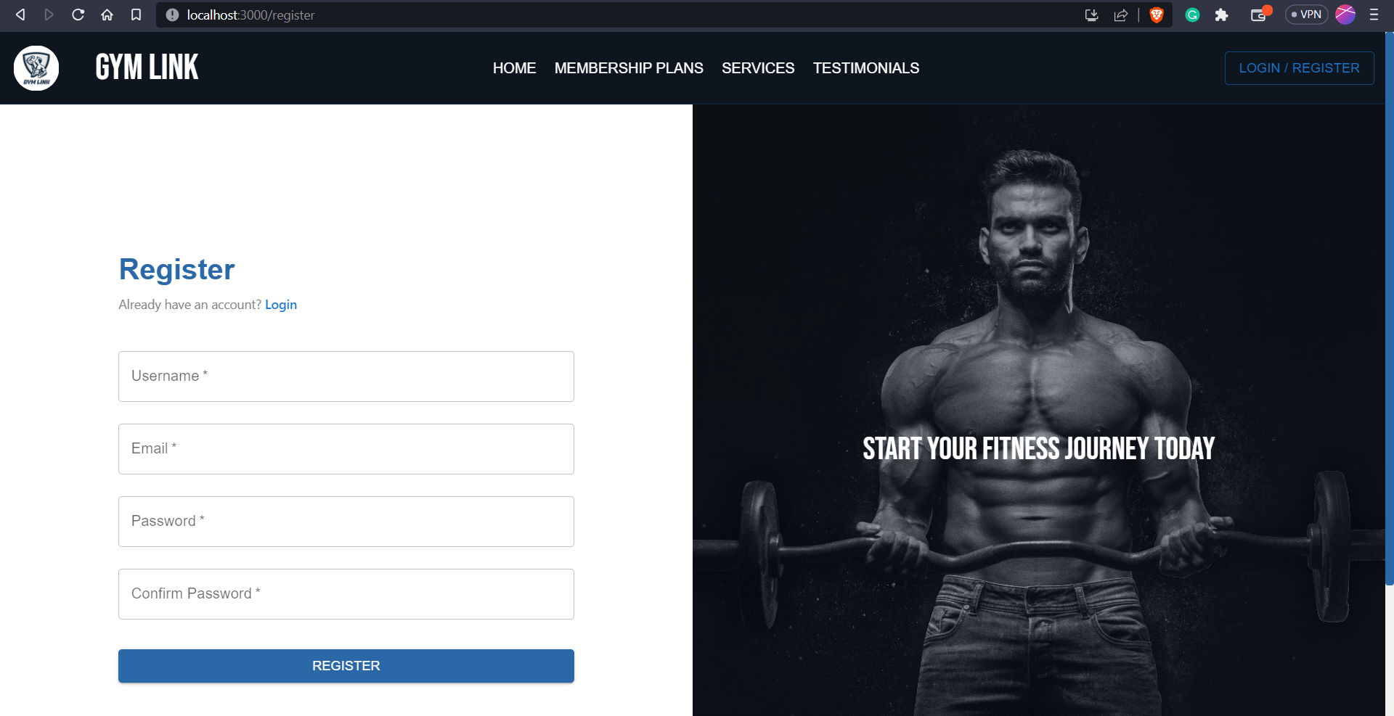

Slide 27
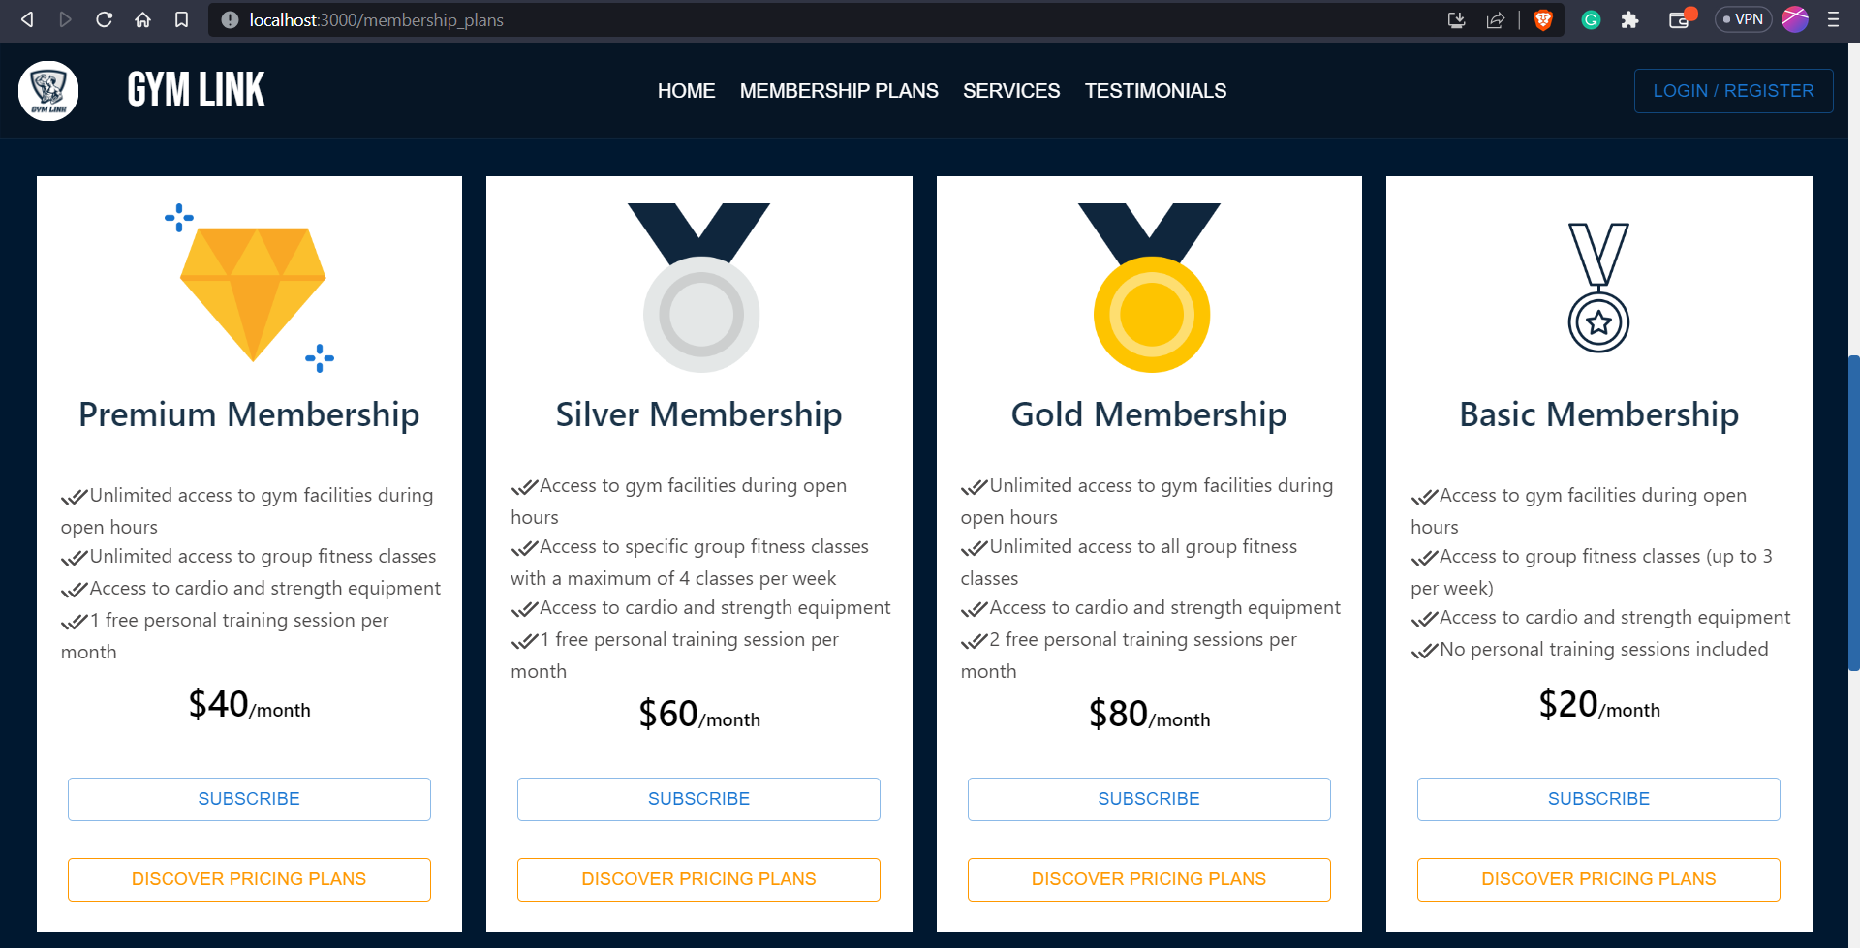

Slide 28
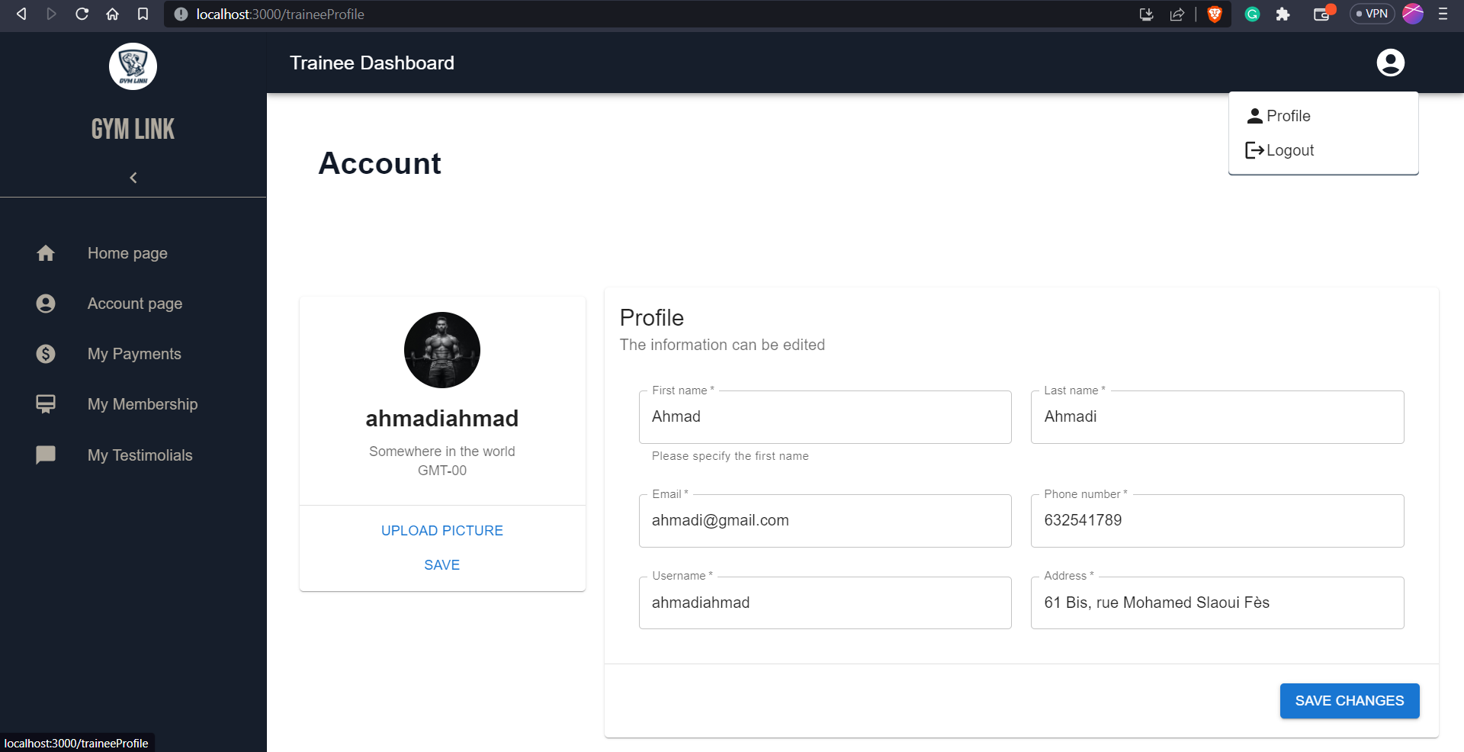

Slide 29
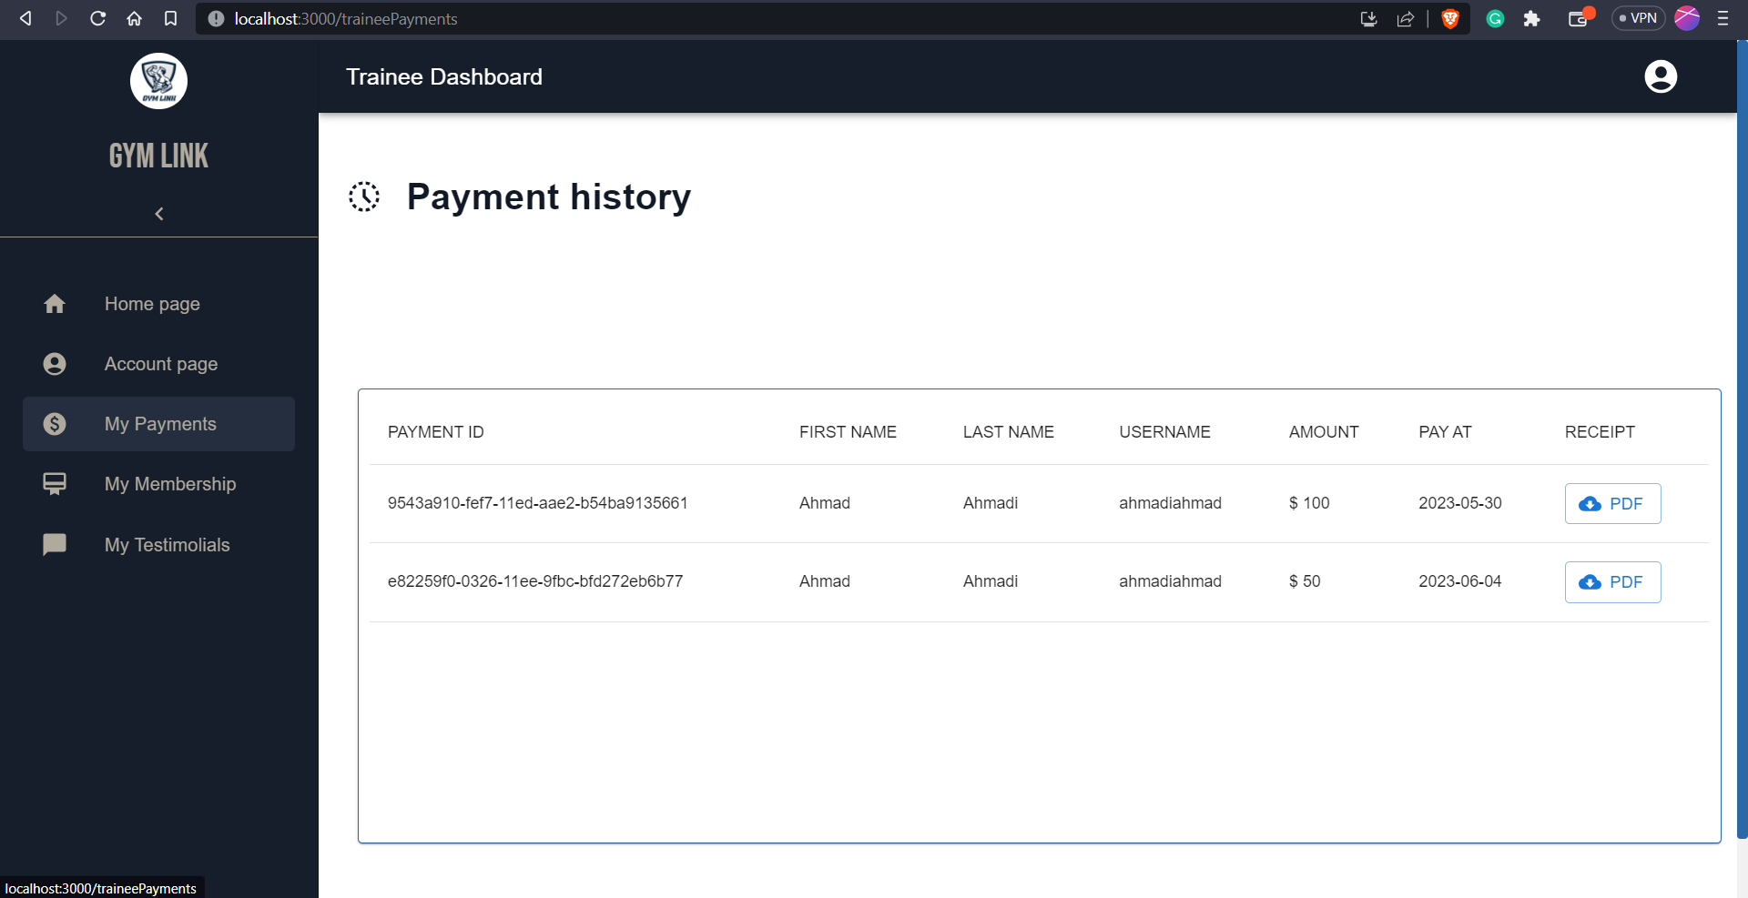

Slide 30
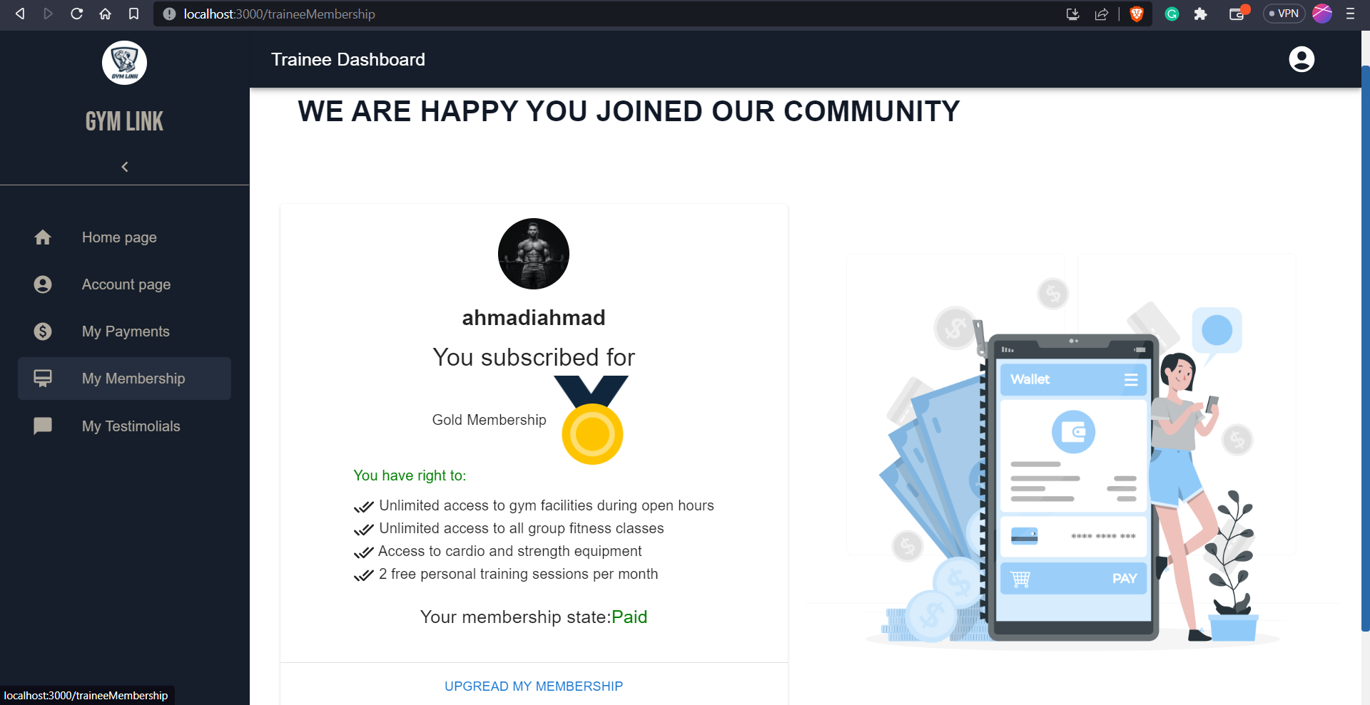

Slide 31
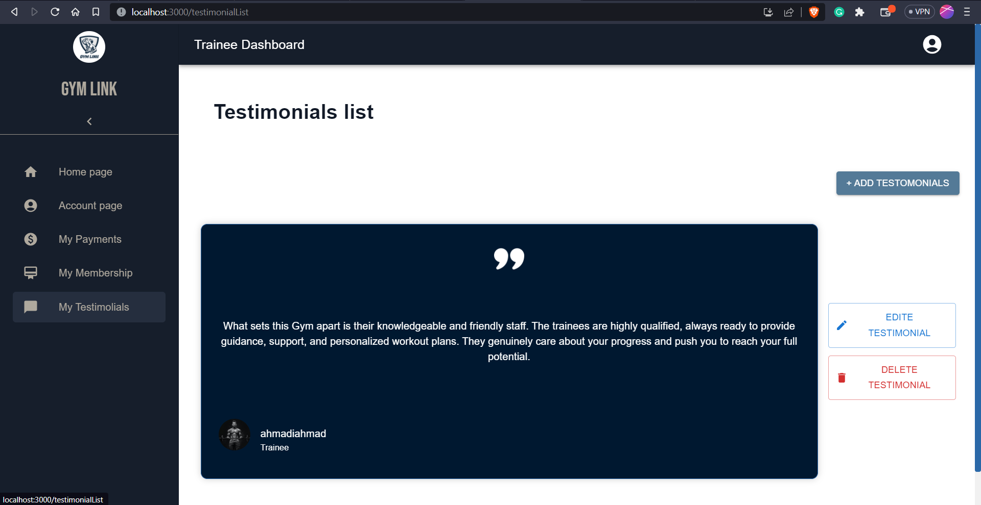

Slide 32
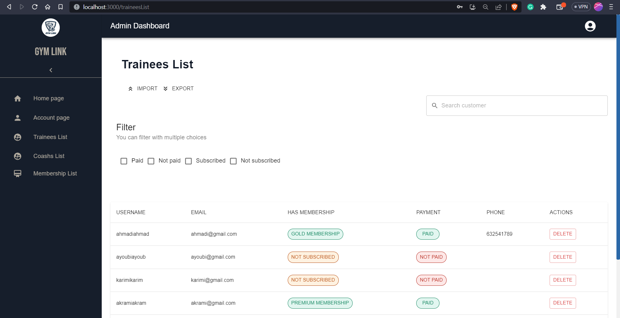

Slide 33
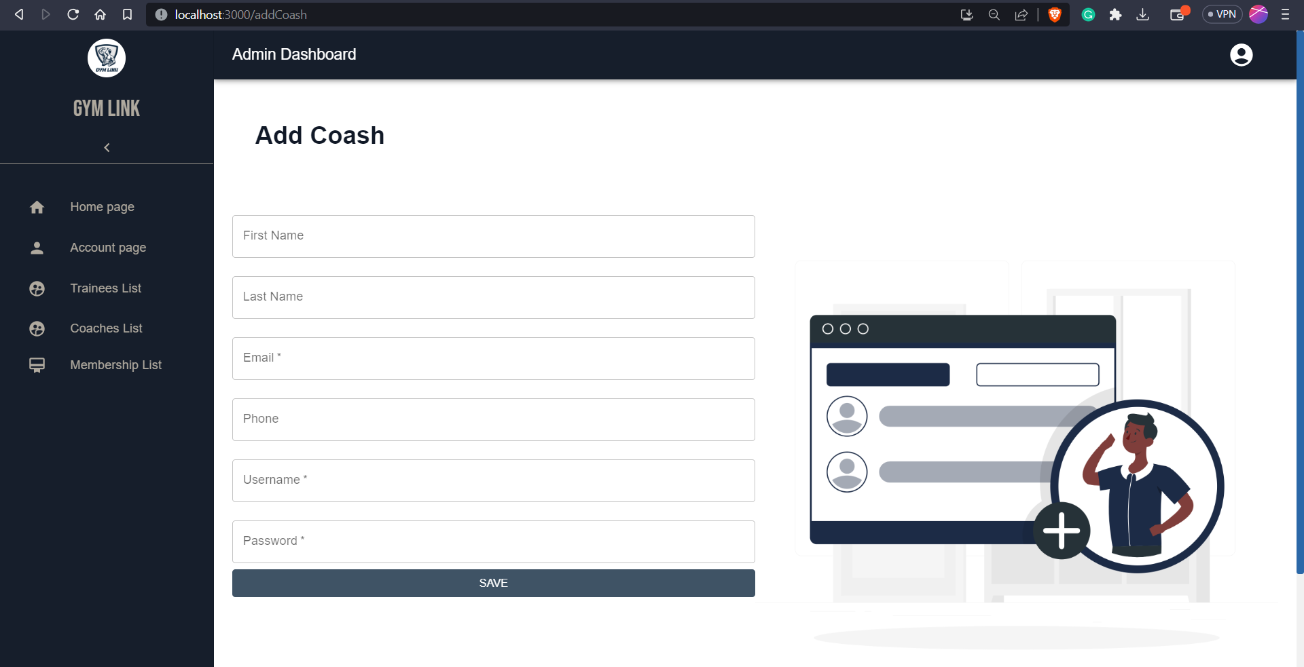

Slide 34
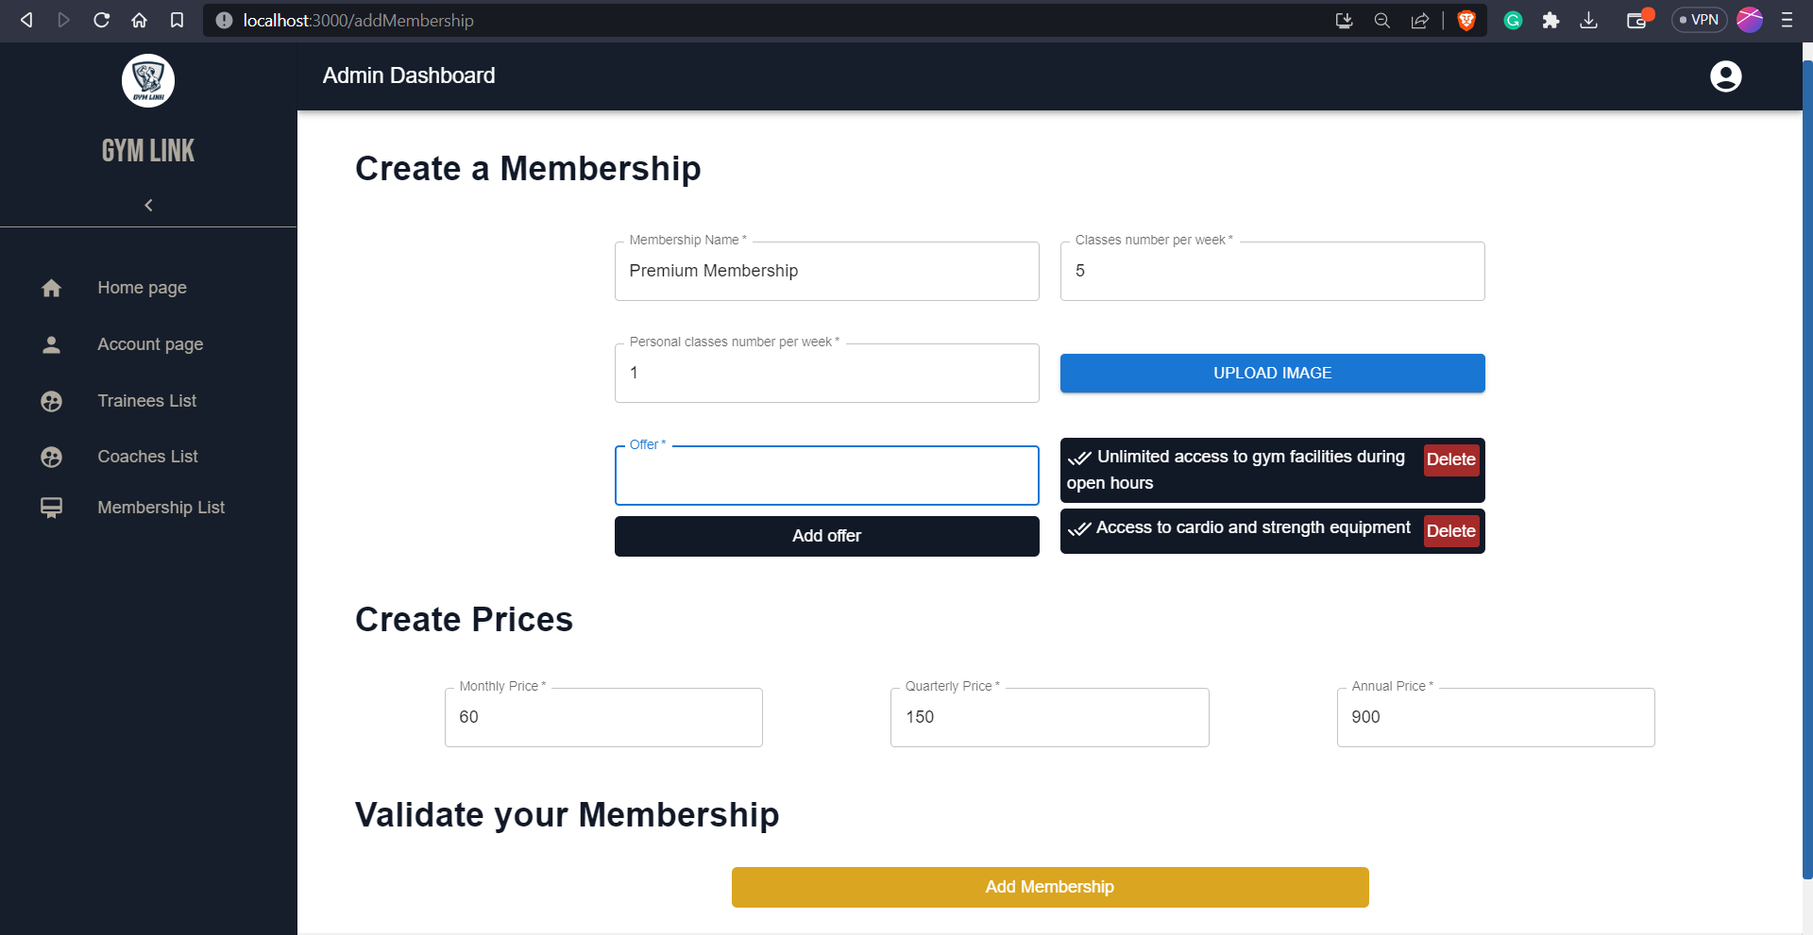

Slide 35
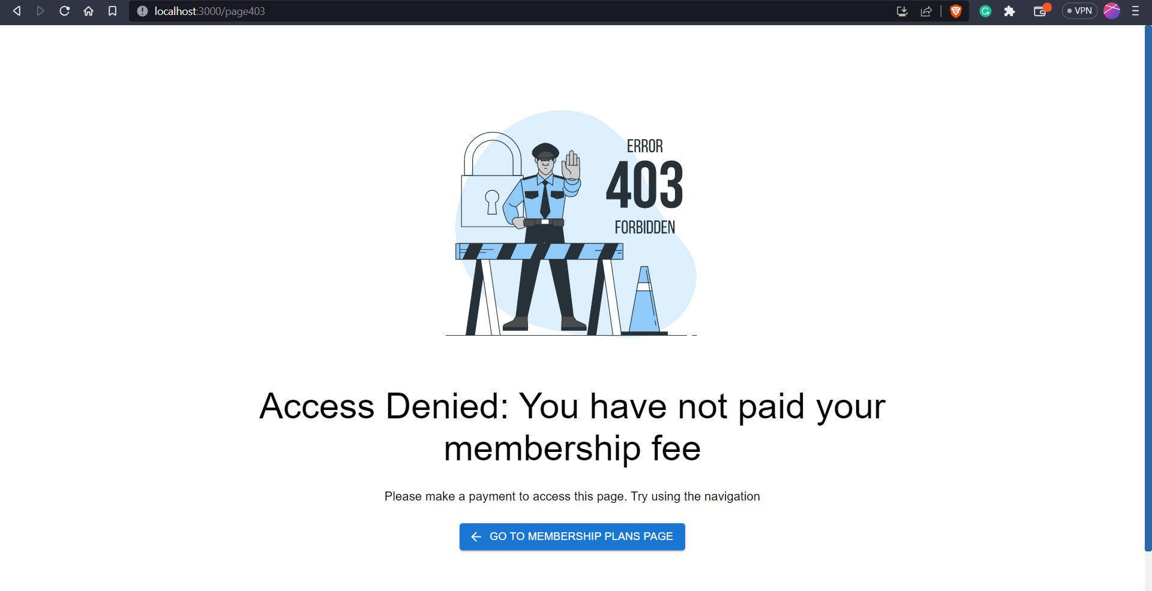

Slide 36
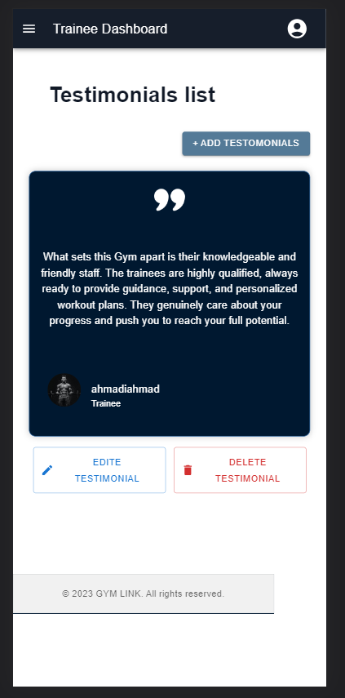
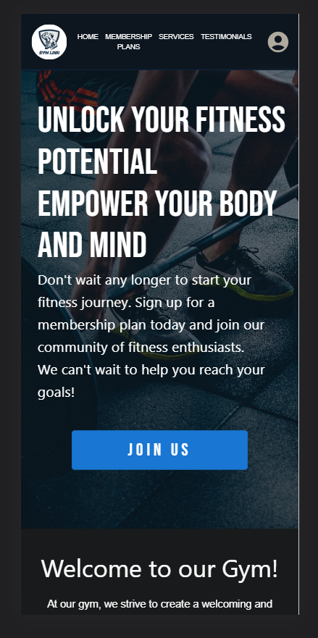
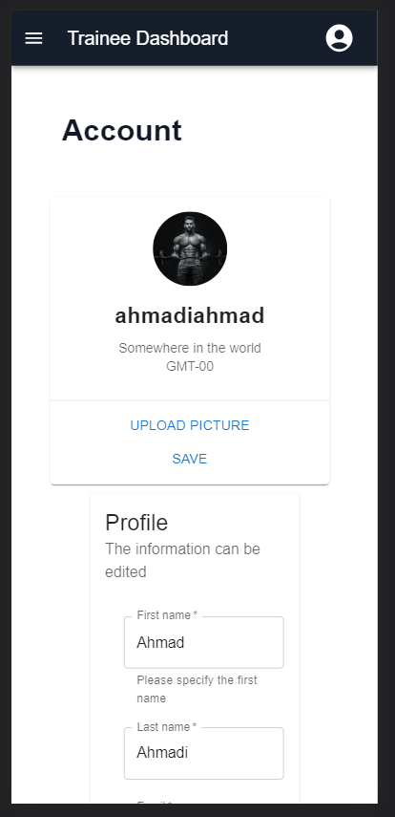
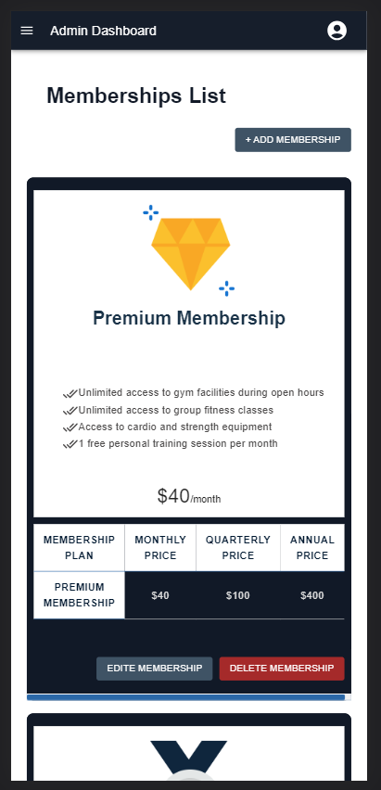

Slide 37
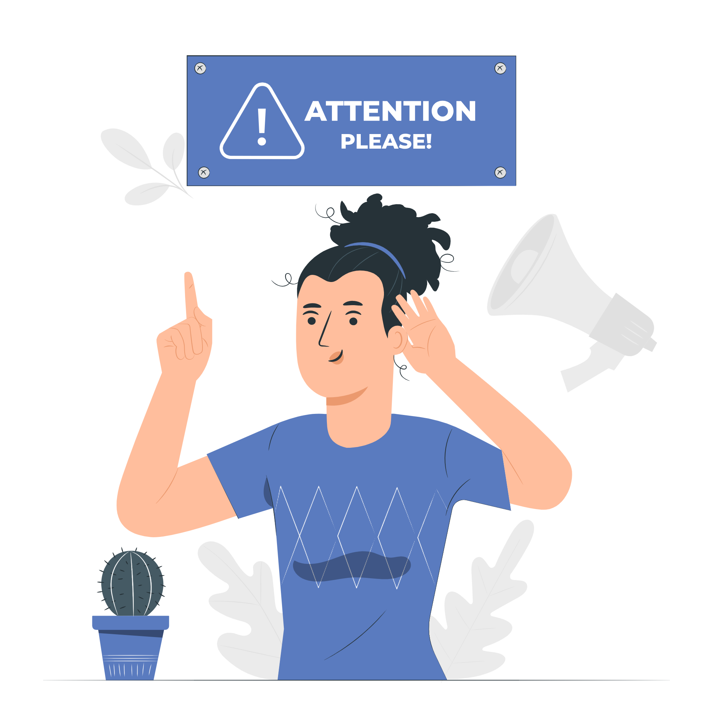
Despite facing time constraints, I am determined to continue expanding the functionalities of the Gym Link app. While I have made progress in its development, there are certain features that were not completed within the allotted timeframe. However, I am committed to ensuring that these functionalities are added in the near future. I recognize the importance of continually improving and refining the app to meet the evolving needs of gym management and members.

Slide 38
Conclusion

Slide 39
Conclusion
Throughout the period of developing this application, various aspects of gym operations and member experiences were explored, analyzed, and addressed. The project aimed to improve the efficiency of gym management

